Slide 1
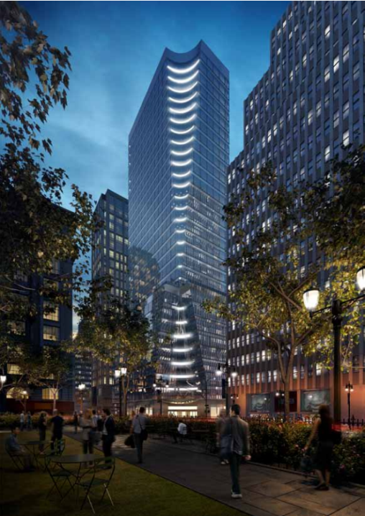
The Tower
Image courtesy of Hines
Shivam Patel
CM Option
Technical Assignment 1
Dr Ed Gannon
September 16th 2013

Slide 2

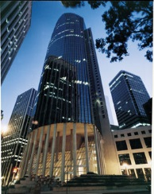
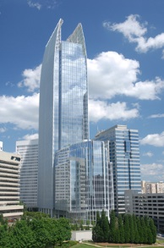
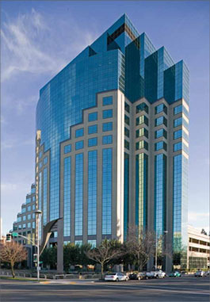
Client Information Project Delivery System Staffing Plan
Existing Conditions Schedule Summary Systems Summary
Cost Evaluation
Privately owned real estate firm
Purpose for building The Tower?
Cost, quality, schedule, safety expectations
Sequencing issues
Keys to completing project to satisfaction
Images from Hines website
Notes:
Developer, Investment manager of various properties
Offices in 18 countries and has a presence in more than 100 cities
Investment strategy to own a building in the location of construction. High quality facility which would be leased to new tenants.
Main goal is to construct the project safely but also ensure quality.
Scheduled Mechanical Penthouse on critical path to ensure delivery of equipment is on time and prevent any delays for the tenant. 2nd building in city to have a concrete core with steel framing. Ensure core is properly built and safely built.
#1 Cost, #2 Quality, #3 Having options for tenants.
Hines Logo: http://www.pasadenanow.com/main/wp-content/uploads/2013/01/Hines-logo.jpg
Hines Building Photos: http://www.hines.com

Slide 3
Client Information Project Delivery System Staffing Plan
Existing Conditions Schedule Summary Systems Summary
Cost Evaluation
Notes:
Mainly Lump Sum Contracts are established between the owner Hines and the architect Pei Cobb Freed and from the architect to the engineers
The delivery method is CM @ Risk with a GMP contract
Hines leased the property from Pacolet/Milliken Enterprises for 100 years
Turner has Lump Sum contracts with all the subcontractors
Hines has done work with Turner in the past.

Slide 4
Client Information Project Delivery System Staffing Plan
Existing Conditions Schedule Summary Systems Summary
Cost Evaluation
Notes:
Office located block away from project site.
Everyone works out of the office except the Project Executive
A BIM team has been placed in the office led by Arthur D’Antonio
Each member coordinates with different trades. Chris Stafford maintains relations with all MEP subcontractors and MEP engineering firm Jaros, Baum, Bolles

Slide 5
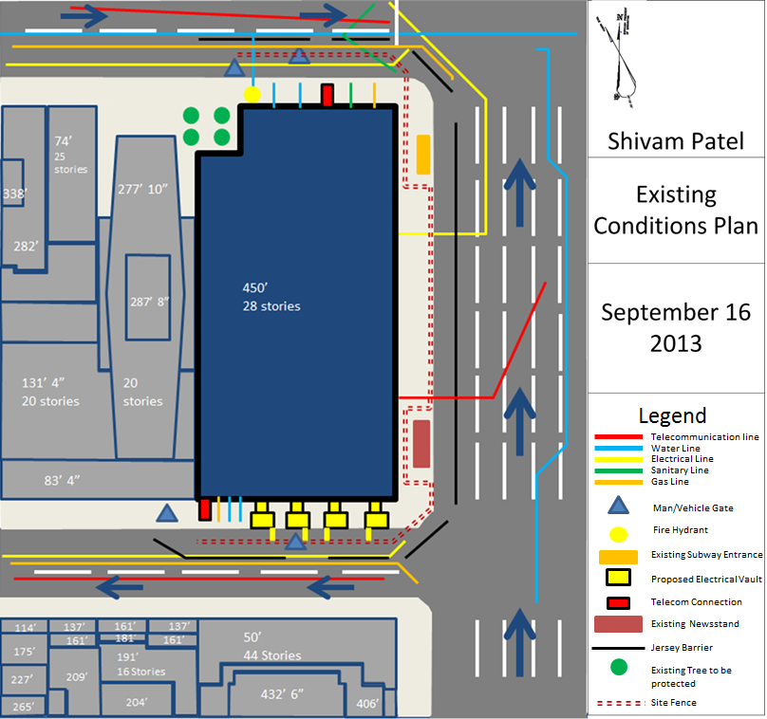
Client Information Project Delivery System Staffing Plan
Existing Conditions Schedule Summary Systems Summary
Cost Evaluation
Notes:
Project Site is very tight
Will be tallest building in vicinity once completed
All utility lines go into the building from the North and South ends.
Jersey Barriers used because site fence extends to sidewalk. Surrounding roads have gotten tighter in order to open up a path for pedestrians.
Deliveries can be difficult because of one way and one lane streets at the North and South side of the site.

Slide 6
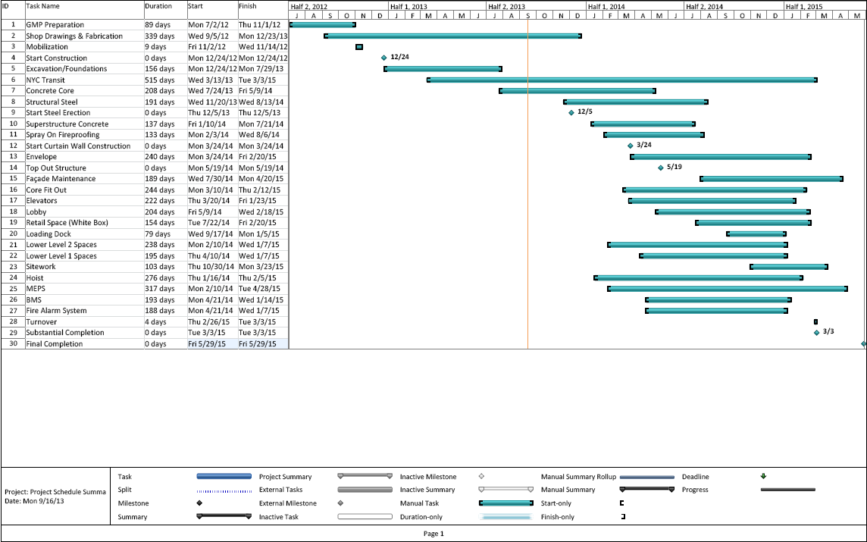
Client Information Project Delivery System Staffing Plan
Existing Conditions Schedule Summary Systems Summary
Cost Evaluation
Notes:
Bottom up construction
Longest duration is Metro addition
Break ground: December 24th 2012
Substantial completion: March 3rd 2015
Final Completion: May 29th 2015
Open New MTA Entrance & Connections: March 3rd 2015

Slide 7
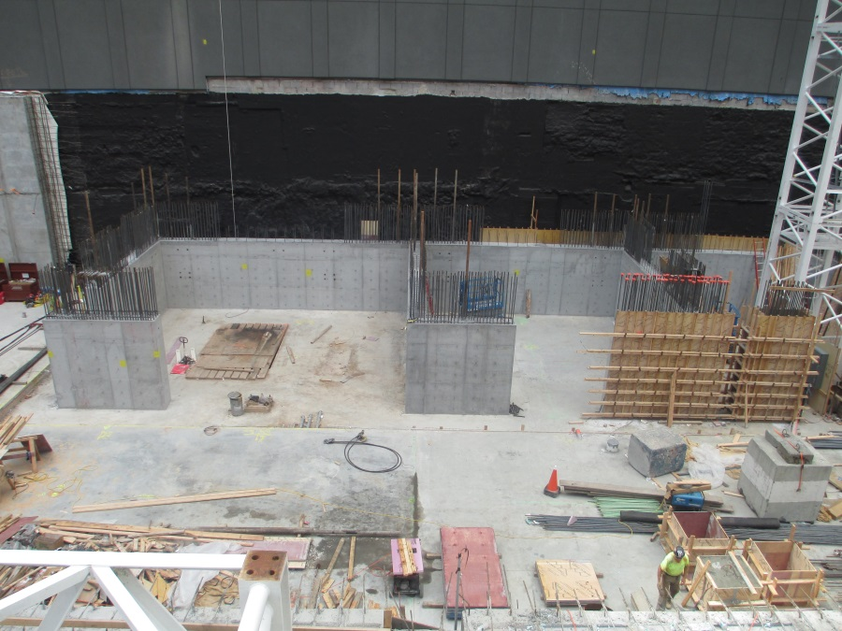
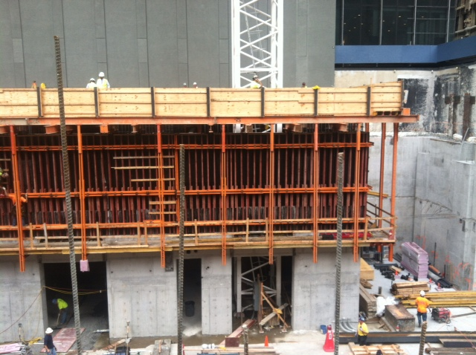
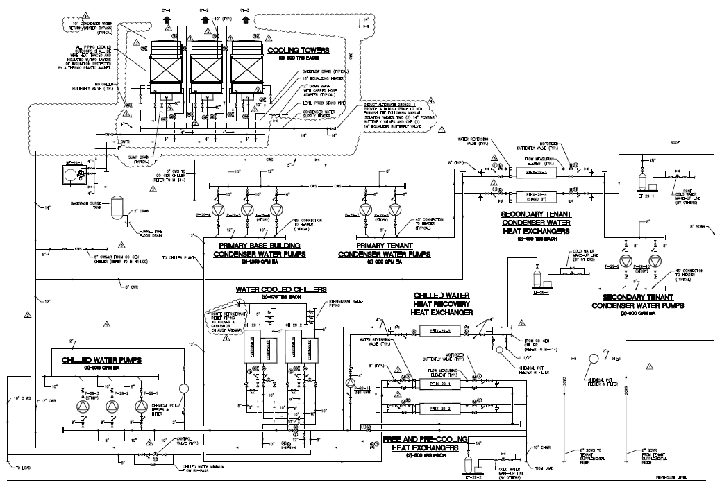
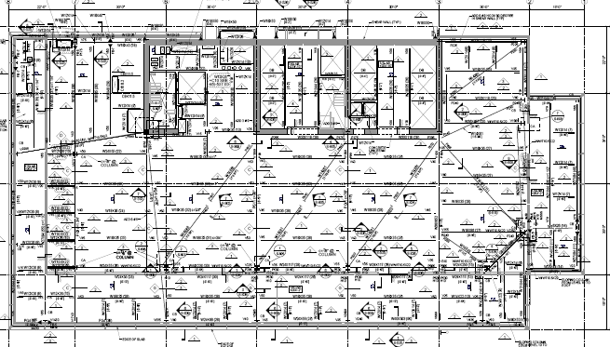
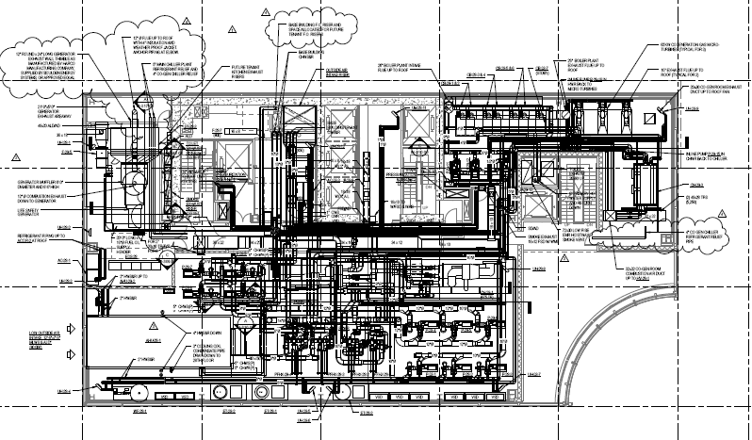
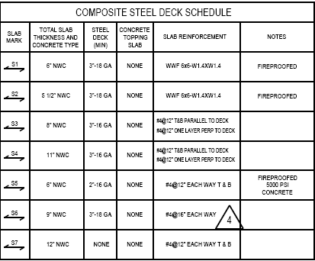
Client Information Project Delivery System Staffing Plan
Existing Conditions Schedule Summary Systems Summary
Cost Evaluation
Yes | No | Scope of Work
 | X | Demolition Required
X |  | Structural Steel Frame
X |  | Cast in Place Concrete
 | X | Precast Concrete
X |  | Mechanical System
X |  | Electrical System
 | X | Masonry
X |  | Curtain Wall
X |  | Support of Excavation
Notes:
Structural
Demolition to existing building was done before Turner was awarded the project. Project site was a flat lot when taken over.
Slab on Metal deck: Lower level 1 has a slab of 9” NWC reinforced with WWF (6x6 –W2.9xW2.9) From floors 1-9 slabs are 6” NWC with a 3”-18 GA metal deck. These slabs are reinforced with Welded Wire Fabric (6x6 -W1.4xW1.4). Level 10 has 6” NWC with a 2”-16 GA metal deck. Level 10 slabs are reinforced with #4 rebar@12” each way top and bottom. The deck is also fireproofed with 5000 PSI concrete. Levels 11-28 the slabs are 5 ½” NWC with a 3” GA metal deck and is reinforced with WWF (6x6 -W1.4xW1.4)
Steel Beams range in a variety of sizes. Floors 2-9 use a majority of 127x94, 12x14, and 18x35. Level 10 uses the most structural steel. Again 12x14 and 18x35 isused, but also 14x61, 33x118 and 24x55 are used. Floors 11-28 use a majority of 121x50, and 12x14
All Beams are supporting the concrete core and vice versa
Two cranes onsite. An assist crane is used during the construction of the core. Once structural steel sequence begins a larger tower crane will be used.
Cast in Place Concrete
Core will contain 9 Public elevators, Mechanical, Telecom, and a Electrical rooms along with stairs and bathrooms (2-9).
Concrete Core poured using pneumatic formwork system. The hydraulic system is an efficient system us more regular in high rise construction. Allows working deck to rise with system.
Mechanical System
3 Chillers on top of roof. (2 traditional 1 absorption) Space for additional chiller in future.
7 Condensing boilers located in mechanical penthouse. Water from these boilers are used to provide heating and cooling
Heat recover pump circuit supplies hot water.
A combined heat and power is used for a secondary circuit. 3 65 kW micro turbines also found in the mechanical penthouse are sized to handle the base load of the building.
Air conditioning unit provides fresh air for each floor. All located in mechanical rooms on floors
Still water detention tank installed on roof. This is used to collect rain water and provides water for sprinkler system if power is lost. This also is used for when heavy storms occur preventing the water discharging directly into the sewer.
An automatic sprinkler system will be provided throughout the building
Standpipe outlets will be provided at each floor level within every exit stairway. Hose connections will be located at the riser on each floor level landing and on the entrance floor above the standpipe riser control valve.
Voice Alarm communication system, and sprinkler system will be provided with water flow devices and alarm system will activate upon water flow.

Slide 8
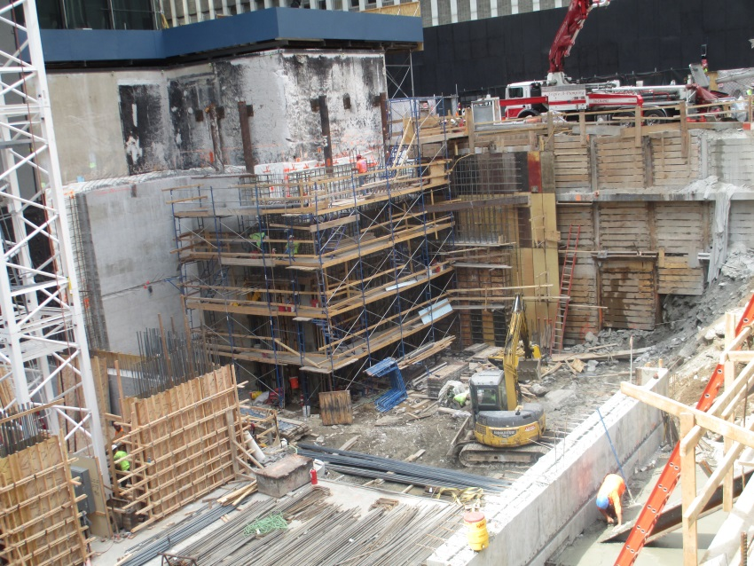
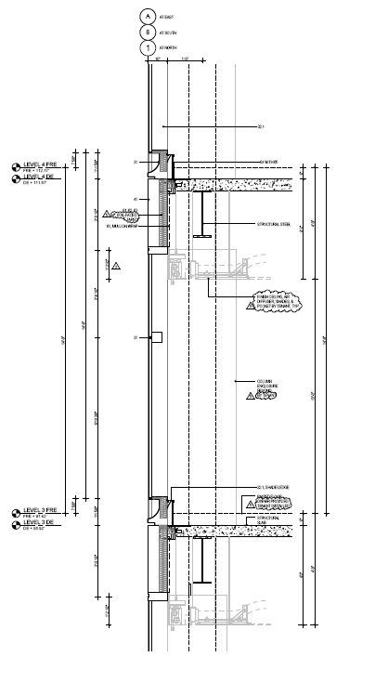
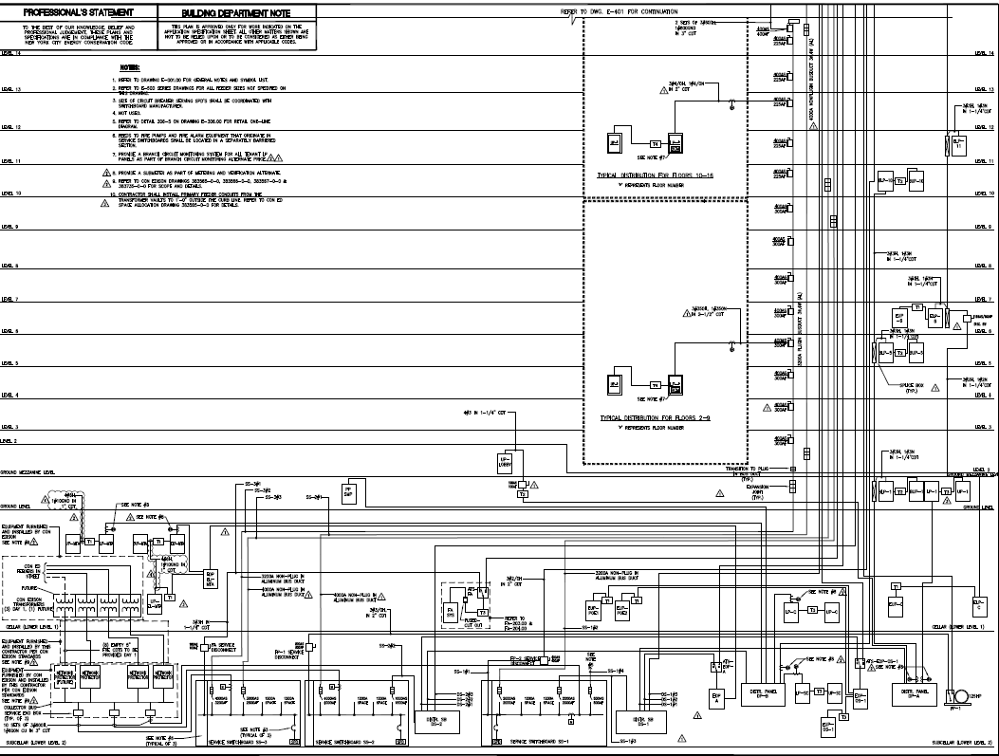
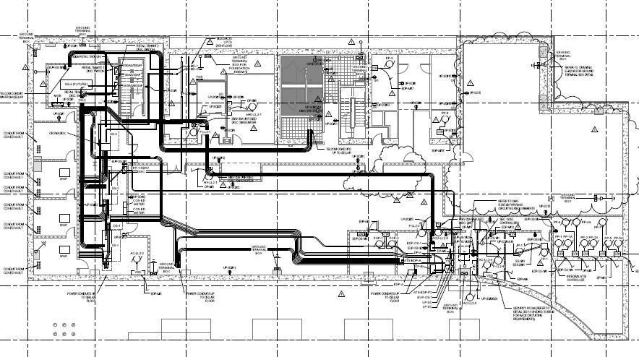
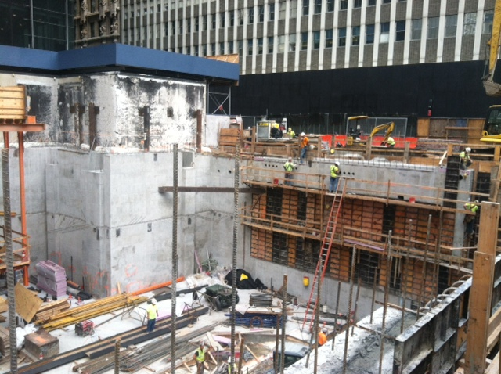
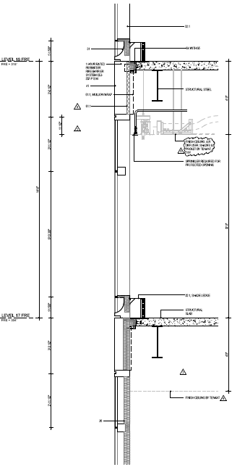
Client Information Project Delivery System Staffing Plan
Existing Conditions Schedule Summary Systems Summary
Cost Evaluation
Yes | No | Scope of Work
 | X | Demolition Required
X |  | Structural Steel Frame
X |  | Cast in Place Concrete
 | X | Precast Concrete
X |  | Mechanical System
X |  | Electrical System
 | X | Masonry
X |  | Curtain Wall
X |  | Support of Excavation
Notes:
Electrical
3 transformers provided by Con Edison located in Lower Level 1. There is a space for an additional transformer in the future. The transformer provided by con ed are responsible for stepping down the power to a 265/460 V. These transformers run through network protectors found in Lower Level 2 and from here are ran through 3 switchboards at 265/460V 3 phase power 4 wires with a bus rating of 4000A. SS1 feeds to a breaker in the mechanical penthouse and back down to distribution switchboard. From the switchboard power is fed through various transformers that drops the power to 120/208V 3 phase 4 wires. SS2 and SS3 runs power to floors (15-28) and (2-14) respectfully through a bus duct. These switchboards also run through the same breaker on the roof and back down to the other two distribution switchboards.
A diesel generator at 750 kW 3 phase 4 wires is also found in the mechanical penthouse. This is a backup system if there is a loss of power.
Curtain Wall
The entire exterior of the building uses insulating glass. A flatter portion of 1 ¼” and a curved glass at a size of 1 ¾” is used. There are mullions made of aluminum and the wall is considered as a canopy type structure. The curtain wall is installed using various types of brackets depending on the location of the glass. The connection is attached to steel which is attached to the structural slabs. The interior portion of the wall has a combination of insulation, vapor barrier, firesafing, and a smoke seal. A monorail is used on the sides of the building which raises the panel and places it.
Excavation
34 ft excavation
Support system is a concrete tangent wall with grout columns drilled
This support was important as the site is surround by existing streets
A temporary dewatering system was used during the excavation process.

Slide 9
Client Information Project Delivery System Staffing Plan
Existing Conditions Schedule Summary Systems Summary
Cost Evaluation
Notes:
As seen in the table there are a few discrepancies between Turner’s estimate and bid prices compared to my own square foot estimate.
2 separate square foot estimates were done because the parameters for “Story Count” did not go to 28 floors. Also floors 1-9 has a GSF of roughly 19,750/floor and floors 10-Mechanical Penthouse has a GSF of roughly 13,120/floor
The excavation and foundation estimate was significantly lower than the actual estimate of Turners because RS Means only counted for a standard substructure. There are two lower levels with different column and slab sizes than used from the standard RS Means substructure.
With this building being the second concrete core building in the city it changes the scope of work for Turner. RS Means does not consider the amount of concrete used for the core and for the lower levels
The MEP and Curtain systems used for the project significantly differ from the RS Means standard as well.

Slide 10
Thank You
Questions?

